Slide 1
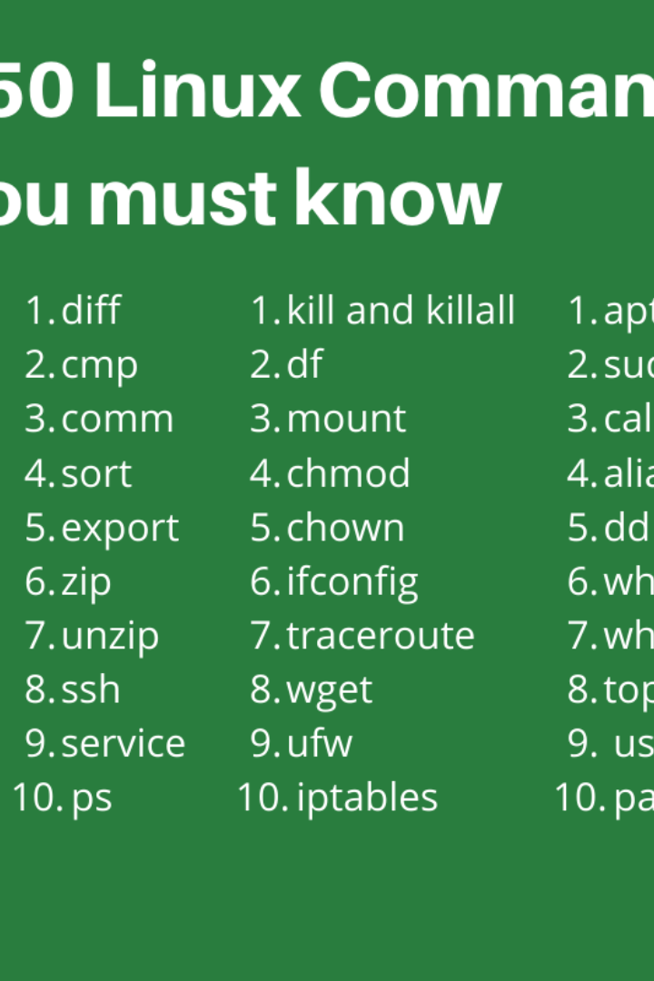

System Calls in Linux
Welcome to the world of system calls in Linux, where the power of the command line meets the inner workings of the operating system. Join us on this journey of exploration!
SB
by Snigdha Bobbili

Slide 2

The Importance of System Calls in Linux
Enhanced Functionality
Discover how system calls enable Linux applications to access the underlying kernel functionality, offering a wide range of powerful features.
Efficient Resource Management
Learn how system calls allow processes to interact with the kernel, optimizing resource allocation and ensuring smooth execution.
Secure Kernel Boundaries
Explore how system calls serve as gateways between user space and kernel space, providing secure access to critical system operations.

Slide 3
Types of System Calls in Linux
1
Process Control
2
File Management
Delve into the world of process control system calls, enabling processes to be created, terminated, and managed effectively.
Uncover the file management system calls, empowering applications to manipulate files, directories, and permissions.
3
Device Management
4
Inter-Process Communication
Discover how device management system calls enable communication with hardware devices, facilitating device configuration and control.
Learn about inter-process communication system calls, enabling processes to share information and synchronize their activities.
5
Memory Management
6
Network Communication
Explore system calls for memory management, empowering efficient allocation, deallocation, and protection of memory resources.
Dive into the world of network communication system calls, facilitating communication over networks and shaping the interconnectedness of systems.

Slide 4
How System Calls Work in Linux
User-Level vs Kernel-Level Interaction
Role of System Libraries and Syscall Interface
Delve into the distinction between user-level and kernel-level interaction, understanding the boundaries and privileges of each layer in the system.
Discover the vital role played by system libraries and the syscall interface, bridging the gap between user applications and the kernel.

Slide 5
Examples of Commonly Used System Calls in Linux
1
Open
Unlock the power of the 'open' system call, enabling access to files and creating new opportunities for reading and writing data.
Read
2
Discover the wonders of the 'read' system call, bringing data from files and other sources into the memory of your applications.
3
Write
Experience the magic of the 'write' system call, unleashing the ability to send data from memory to files and various output destinations.
Close
4
Learn about the 'close' system call, gracefully terminating file access and freeing up system resources.
5
Fork
Explore the 'fork' system call, paving the way for process creation and spawning new instances of your application.
Exec
6
Unlock new horizons with the 'exec' system call, facilitating process execution and allowing you to run different programs within your application.
7
Exit
Discover the clean and efficient 'exit' system call, gracefully terminating your application and freeing up system resources.

Slide 6

Recap of System Calls in Linux
1
System Calls: The Building Blocks
2
Importance and Impact
Revisit the fundamental concepts of system calls and their pivotal role in the Linux operating system's architecture.
Reflect on the significance and far-reaching impact of system calls, shaping the behavior and capabilities of Linux-based applications.

